Slide 1
CONNECTICUT STATE DEPARTMENT OF EDUCATION
Presenters: Ron Michaels
Jeff Greig
CT State Department of Education
April 2017
An Update of
NGSS Implementation/Assessment

Slide 2
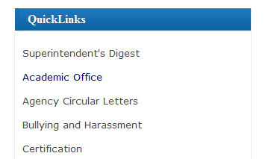
For the latest updates:
http://www.sde.ct.gov

Slide 3
* Subject to change dependent on federal and state law and policies.
** An option for transitioning away from current state standards to teaching NGSS. Districts have flexibility to develop their own transition and implementation plans.
CONNECTICUT STATE DEPARTMENT OF EDUCATION

Slide 4
Supporting Next Generation Science
Connecticut State Department of Education in partnership with The Connecticut Science Center

Slide 5
Building Capacity
Leadership Development Academy (LDA)
Advanced professional development program
Prepares educators to lead expert developed institutes and short courses such as NGSX and Why NGSS….?
Graduates of this academy will become facilitators in supporting Connecticut’s transition to Next Generation Science
Notes:
Leadership Development Academy: graduates of the Next Generation Science Leadership Development Academy (LDA) will become part of the second cohort of professional learning facilitators that is supporting Connecticut’s efforts to transition to a Next Generation approach to science teaching and learning. LDA is an advanced professional development program to prepare Connecticut educators to lead expert-developed institutes and short courses focused on new approaches to science teaching and learning envisioned in the NGSS
.

Slide 6
Web-Based Learning
Next Generation Science- CT Short Course
No-cost
Self-paced
11 modules offering 16 to 60 hours of structured professional learning
Last Module’s released in September, 2016
No plans for any new modules (yet)
Next Gen Science Exemplar System (NGSX)
Hands-on, Expert-facilitated
6 module series over 4 ½ days
Tuition fee of $1500
30-36 hours of seminar-style learning
Plans for several more “cohorts” have been announced
Notes:
As a result of participating in professional learning, educators will be able to make informed and appropriate NGSS modifications to curriculum, classroom culture, and instructional materials.
Next Generation Science-CT: an introduction to Next Generation Science Standards (NGSS) and a broad overview of the changes to science teaching and learning envisioned in the Framework for K-12 Science Education (National Research Council, 2012).
Next Gen Science Exemplar System (NGSX): a web-based, expert-led experience of a “3-Dimensional” culture of science learning, where students use science “practices” (specifically modeling and arguing with evidence) and “crosscutting concepts” to co-construct scientific explanations of real-world phenomena.

Slide 7
A few more opportunities…
Curriculum Unit Development Institute
Designed for curriculum writers and teachers
Expert facilitated
5 days
Offered through the CT RESC system
2 presently available www.crec.org/protraxx/docs/362373/att.pdf
www.learn.k12.ct.us/Common/News2/HomePagePopUps/?DivisionID=0&DepartmentID=0&SubDepartmentID=0&CalendarID=717718&iSrc=TopEvent
Transitioning to NGSS: A Video Collection
A collection of videos showing CT educators teaching 3 dimensional NGSS lessons in several classroom settings.
No cost/Self-paced
Released in October, 2016
Notes:
As a result of participating in professional learning, educators will be able to make informed and appropriate NGSS modifications to curriculum, classroom culture, and instructional materials.
Next Generation Science-CT: an introduction to Next Generation Science Standards (NGSS) and a broad overview of the changes to science teaching and learning envisioned in the Framework for K-12 Science Education (National Research Council, 2012).
Next Gen Science Exemplar System (NGSX): a web-based, expert-led experience of a “3-Dimensional” culture of science learning, where students use science “practices” (specifically modeling and arguing with evidence) and “crosscutting concepts” to co-construct scientific explanations of real-world phenomena.

Slide 8
More Opportunities to Come…
Why NGSS…? 2-day NGSS Awareness PD
PLANS - Principals Learn About, Network, and Support 3-Dimensional Science Learning
Evaluating Commercial Instructional Materials
(Using the Achieve Equip Rubric vers. 3)
CSDE Sample Performance Tasks (Field Tests)
Development of storylines (MSP /TQP grants)

Slide 9
NGSS Storylines
Next Generation Science Storylines project is dedicated to providing tools that support teachers in developing, adapting, and teaching with strongly aligned NGSS materials in classrooms around the country.
Check out the latest Storylines at http://www.nextgenstorylines.org
Notes:
Leadership Development Academy: graduates of the Next Generation Science Leadership Development Academy (LDA) will become part of the second cohort of professional learning facilitators that is supporting Connecticut’s efforts to transition to a Next Generation approach to science teaching and learning. LDA is an advanced professional development program to prepare Connecticut educators to lead expert-developed institutes and short courses focused on new approaches to science teaching and learning envisioned in the NGSS
.

Slide 10
Phenomena Resources
Using Phenomena in NGSS-Designed Instruction (Interview with Brian Reiser) http://www.nextgenscience.org/resources/phenomena http://www.nextgenscience.org/sites/default/files/Using%20Phenomena%20in%20NGSS.pdf
NGSS EQuIP Rubric Using Phenomena http://www.nextgenscience.org/resources/ngss-equip-rubric-using-phenomena
STEM Teaching Tools-Phenomenon http://stemteachingtools.org/brief/28
Integrating Science Practices Into Assessment Tasks (Research+ Practice Collaboratory) http://researchandpractice.org/ngsstaskformats/
Professional Development Tool: Qualities of a Good Anchor Phenomenon for a Coherent Sequence of Science Lessons http://researchandpractice.org/resource/anchor_phenomena/
Explaining Phenomena and Solving Problems as a Central Shift in the Next Generation Science Standards Vision for Science Teaching and Learning http://scimath.unl.edu/noyce/conferences/2014/_files/slides/Campbell_NGSS.pdf
Developing Assessments for the NGSS https://concord.org/publications/newsletter/2014-fall/developing-assessments-for-the-ngss
6 Steps to Coming Up with an Engaging Phenomenon to Anchor Your Next NGSS Unit https://www.teachingchannel.org/blog/ausl/2015/04/15/6-steps-to-coming-up-with-an-engaging-phenomenon-to-anchor-your-next-ngss-unit/
Transitioning to the NGSS: Tips and Resources for Planning Science Units Around Puzzling Phenomena
https://www.teachingchannel.org/blog/ausl/2014/09/22/transitioning-to-the-ngss-tips-and-resources-for-planning-science-units-around-puzzling-phenomena/
Phenomena for NGSS (TJ McKenna)http://www.ngssphenomena.com/ https://www.rubicon.com/ngss-using-phenomena-engage-students/ https://www.rubicon.com/offerings/professional-development/events/spark-ngss-using-phenomena-engage-students/ (webinar)
#ProjectPhenomena https://sites.google.com/site/sciencephenomena/
Notes:
Leadership Development Academy: graduates of the Next Generation Science Leadership Development Academy (LDA) will become part of the second cohort of professional learning facilitators that is supporting Connecticut’s efforts to transition to a Next Generation approach to science teaching and learning. LDA is an advanced professional development program to prepare Connecticut educators to lead expert-developed institutes and short courses focused on new approaches to science teaching and learning envisioned in the NGSS
.

Slide 11
CONNECTICUT STATE DEPARTMENT OF EDUCATION
March/April 2017
Update on
Next Generation Science Assessments

Slide 12
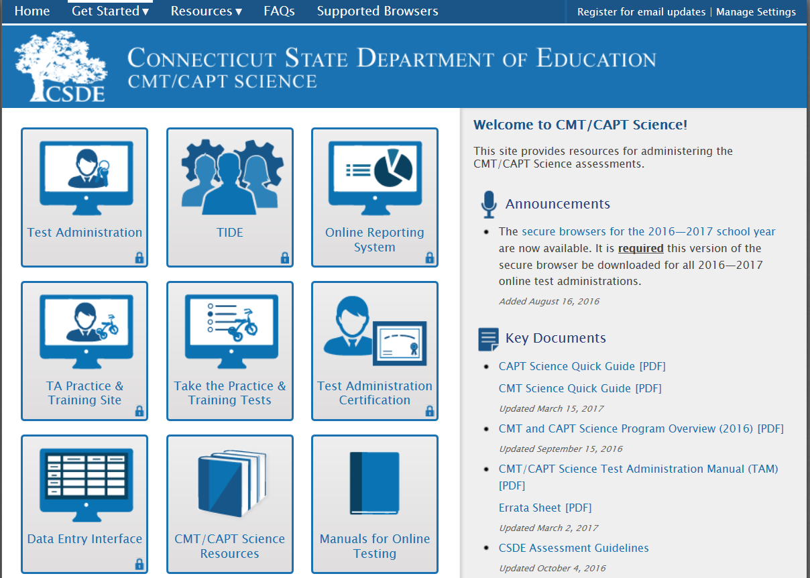
State Science Assessments Online
Starting with the spring, 2017 administration, almost all students will be tested online*
in science using the same Test Delivery System (TDS) as Smarter Balanced.
Further information about online testing,
including brief practice tests, can be found
on the CT Comprehensive Assessment Portal
at http://ct.portal.airast.org.
Scheduling the online science assessments
will be more flexible than in the past
(i.e., students can test on different days and
times within a school). Note that the science
assessments are timed tests and a science
test session must be completed on a
single day.
* The main exceptions are students requiring a large-print or Braille version of the test as well as students placed out-of-state or in non-approved special education facilities. These students will take a paper-and-pencil version of the test.
CONNECTICUT STATE DEPARTMENT OF EDUCATION

Slide 13
Proposed Science Assessment Timeline (2017-)
The Next Generation Science Standards (NGSS) were adopted by the
CT State Board of Education on November 4, 2015.
NGSS can be accessed at www.nextgenscience.org.
Year | Census Tests* | Pilot/Field Tests
2017 | Aligned to 2004 CT Science Standards Grades 5, 8 and 10 | Aligned to NGSS Grades 5, 8 and 11
2018 | Aligned to 2004 CT Science Standards Grades 5 and 8 only | Aligned to NGSS Grades 5, 8 and 11
2019** and beyond | Aligned to NGSS Grades 5, 8 and 11 | Aligned to NGSS Grades 5, 8 and 11
* Includes the standard CMT and CAPT Science and the Skills Checklists Science.
** Low-stakes assessments in 2019 (results not included in school and district accountability).
The CMT & CAPT Science administration window has moved starting in 2017:
March 27 – April 28, 2017
CONNECTICUT STATE DEPARTMENT OF EDUCATION

Slide 14
Spring 2017 NGSS Assessment Pilot Test
Purpose: to try out new assessment items and gather data/feedback.
Dates: May 1-26, 2017
Grades: 5, 8 and 11 (randomized, representative sample). All students within a grade should participate.*
Districts/Schools Selected: Most districts in state, one or more schools in a district, only one grade per school.
Administration: Online using AIR’s Test Delivery System (same used for Smarter Balanced and CMT/CAPT Science). Testing supports and accommodations will be available (e.g., extended time, Text-to-Speech)
Time: Approximately 1 hour plus 10 minutes for directions. Students do not need to be tested on same day or time (i.e., can cycle students through rooms with computers over several days).
Feedback: Students and teachers can complete optional feedback surveys.
Sample Test Items: Will be available in mid-April (optional).
* Exceptions includes students taking the CMT/CAPT Science Skills Checklist. There will be no large print or Braille versions available for the pilot test.
CONNECTICUT STATE DEPARTMENT OF EDUCATION

Slide 15
NGSS Assessment Development
CT is following recommendations and using resources from national experts and state collaborative efforts. This includes the National Research Council’s report: Developing Assessments for the Next Generation Science Standards*.
CT is working with several other states and our testing contractor, American Institute for Research (AIR), to develop and share NGSS assessment resources and an item pool for statewide tests.
NO national or multi-state consortium tests (e.g., Smarter Balanced or PARCC) are anticipated for science.
*Available through The National Academies Press at www.nap.edu.
A practitioner’s guide for classroom teachers is also being developed.
CONNECTICUT STATE DEPARTMENT OF EDUCATION

Slide 16
Proposed System of NGSS Assessments
The goal is to provide useful information for a variety of purposes and audiences.
Formative Assessments Resources: Used every day by teachers to monitor student learning in the classroom and help make ongoing instructional adjustments to meet student learning needs. VOLUNTARY
Interim Assessments Resources: Assessments administered at the end of units or grades to evaluate the learning of groups of students to inform curriculum and instruction at the local level. VOLUNTARY
Greater frequency of use
More useful to students and teachers
State Summative Assessments: Assessments given at end of learning (Grades 5, 8 and 11) to track student learning and inform decisions about curriculum, instruction, professional development, and policy for a variety of stakeholders. MANDATED BY FEDERAL AND STATE LAW
Formative and interim assessment resources will likely come from a variety of sources and be shared by states around the country.
CONNECTICUT STATE DEPARTMENT OF EDUCATION

Slide 17
NGSS State Summative Assessments
Two main purposes: provide valid and reliable results at the individual student level and useful feedback to schools, districts and the state.
Using evidence-based design approach: process of gathering evidence to make claims about student learning. This process was also used to develop Smarter Balanced. Assessment targets are also identified and reported.
Content Domain (Science)
Claims (broad reporting categories)
Targets (specific reporting categories)
CONNECTICUT STATE DEPARTMENT OF EDUCATION

Slide 18
DRAFT NGSS State Summative Assessment Design
Claims and Reporting: One overall claim score (and performance levels) for Science that includes all three dimensions. Claim scores would be reported at the individual student level as well as the school, district and state levels. Additional claim scores may be reported for Life Science, Physical Science and Earth/Space Science that include all three dimensions. Additional scores/descriptors may be provided for Science and Engineering Practices and Crosscutting Concepts.
Matrix Design: Different sets of items will be administered to different students. This design balances the need for valid and reliable individual student scores with providing more useful feedback for schools and districts. Tests will not be adaptive.
Types and Number of Items: Each student would complete a variety of item types representative of Life, Physical and Earth/Space Sciences with approximately 40 items per student.
Testing Time: Likely 90-120 minutes depending on grade (will include embedded field-test items instead of a separate supplemental test session).
CONNECTICUT STATE DEPARTMENT OF EDUCATION

Slide 19
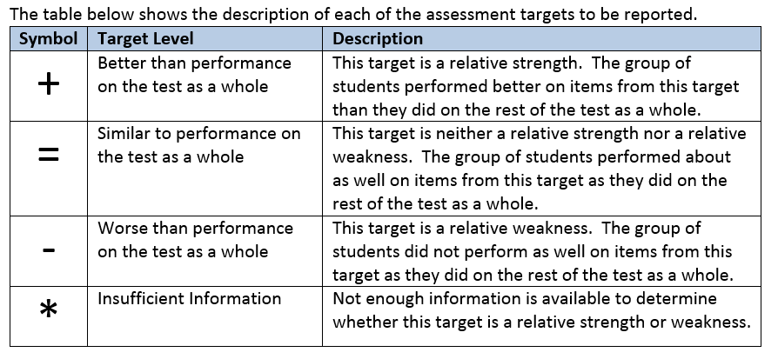
DRAFT NGSS State Summative Assessment Design
Target-level Reporting: The following may be available for schools and districts:
Topic Areas or DCI Arrangements + Engineering and Individual Performance Expectations
Groupings of Science and Engineering Practices
Groupings of Cross-Cutting Concepts
The reporting descriptions shown above are consistent with Smarter Balanced assessments.
CONNECTICUT STATE DEPARTMENT OF EDUCATION

Slide 20
NGSS State Summative Assessment Development
Items are aligned to NGSS performance expectations (PEs) and evidence statements. Each item is aligned to at least 2 dimensions (DCIs, SEPs, CCCs).
Using real-world scientific phenomena as a focus.
A variety of stand-alone items and items clusters are being developed. Some item clusters align to more than one performance expectation (PE bundle).
A variety of item types are being developed including innovative items such as interactions and simulations. A practice site for students will be developed this year.
Items are based on specifications that include additional guidance about the PEs
(e.g. acceptable vocabulary, content limits) that will eventually become public.
More/less emphasis may be placed on certain topic areas and performance expectations based on feedback surveys of CT science education leaders.
Using guidance from Smarter Balanced in terms of item formats, style, wording, etc. (modifying and adding to as needed for science) to maintain consistency.
CONNECTICUT STATE DEPARTMENT OF EDUCATION

Slide 21
NGSS Online Assessment Items
Start with stimuli based on real-world phenomena:
Written text
Data in tables or graphs
Diagrams, drawings, maps, etc.
Animations
Simulations
Variety of item types including:
Selected-Response
Constructed Response
Multi-Select
Graphic Response
Edit Task Inline Choice
Hot-Text Draggable
Table Input
Technology-Enhanced:
Interactions
Simulations
New item types will be developed over time
Use to answer
Items clusters present students with stimuli and items using a split screen.
A variety of test accommodations and supports will be available to make
the assessments accessible to all students. See the current version of the
Assessment Guidelines at the CSDE Web site: www.ct.gov/sde
CONNECTICUT STATE DEPARTMENT OF EDUCATION

Slide 22
Sample NGSS Assessment Items
Sample NGSS assessment items for CT will be available mid-April through AIR’s assessment web portal at http://ct.portal.airast.org/.
Items will be added over time.
California Sample NGSS Items: www.caaspp.org/practice-and-training/
(similar to items being developed for CT and collaborating states)
CCSSO Science Assessment Item Collaborative (SAIC) Background on item clusters with prototypes for Grade 5 and high school
http://www.csai-online.org/spotlight/science-assessment-item-collaborative
The Concord Consortium: https://concord.org/projects/ngss-assessments
Interactive NGSS assessment items (mostly focused on Middle School physical and life science with more to come.)
CONNECTICUT STATE DEPARTMENT OF EDUCATION

Slide 23
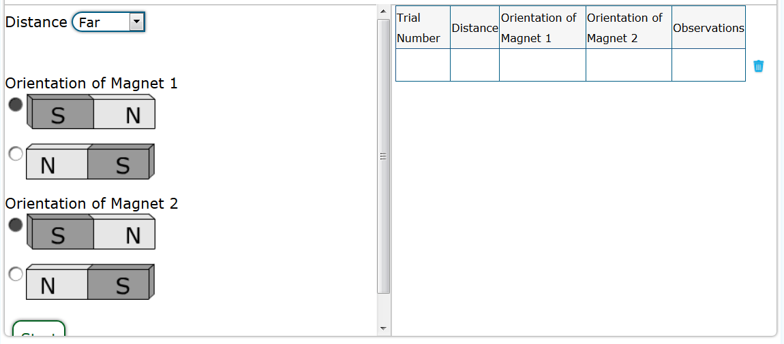
Sample NGSS Assessment Items: For CT
Elementary School Example:
3-PS2-3
Some questions not shown
CONNECTICUT STATE DEPARTMENT OF EDUCATION

Slide 24
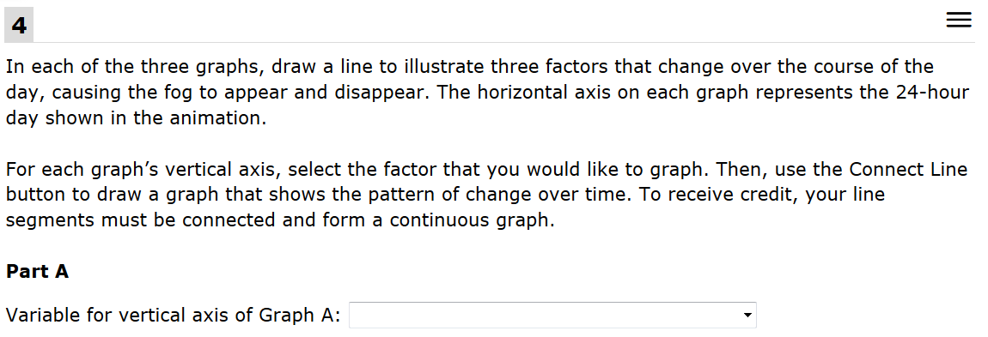
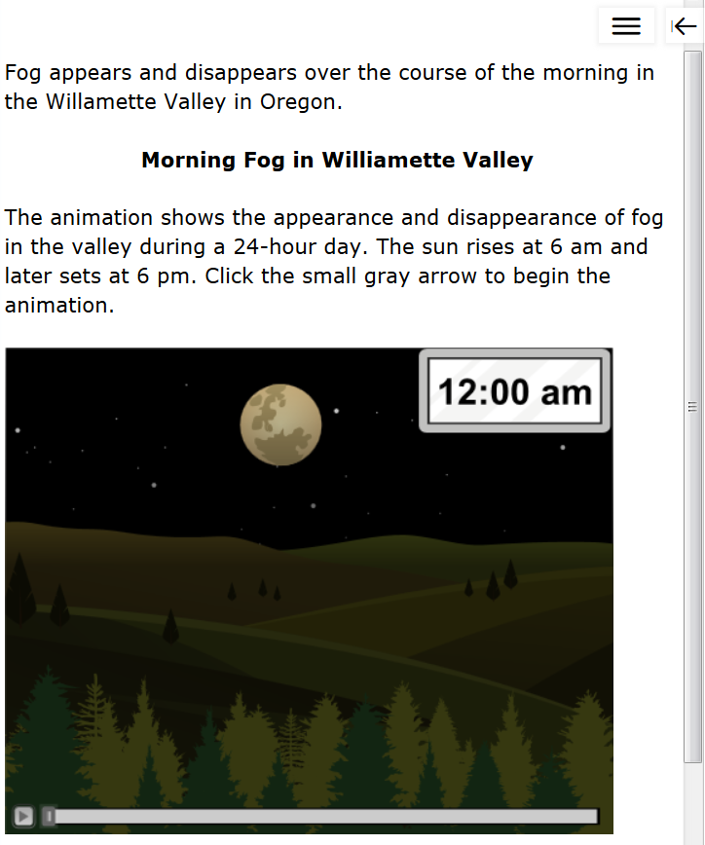
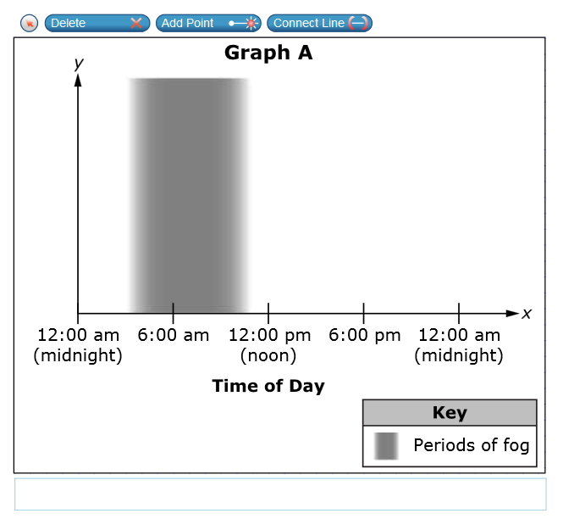
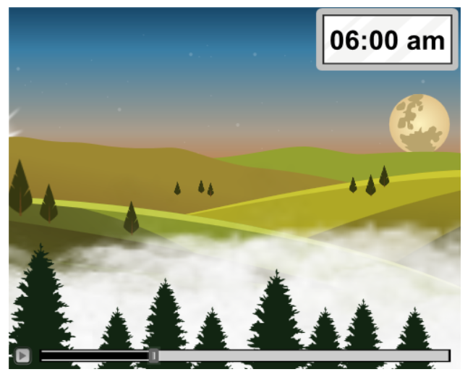
Sample NGSS Assessment Items: For CT
Middle School Example
MS-ESS2-4
Choices:
Air temperature
Amount of cloud cover
Proportion of carbon dioxide in air in liquid form
Proportion of oxygen in air
Proportion of water in air in gas form
Sunlight intensity
Two additional graphs are included
Same choices as shown above.
Some questions not shown
CONNECTICUT STATE DEPARTMENT OF EDUCATION

Slide 25
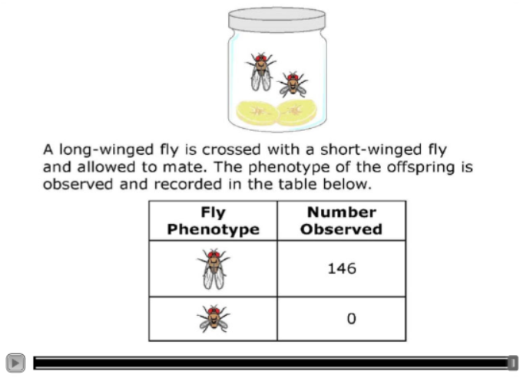
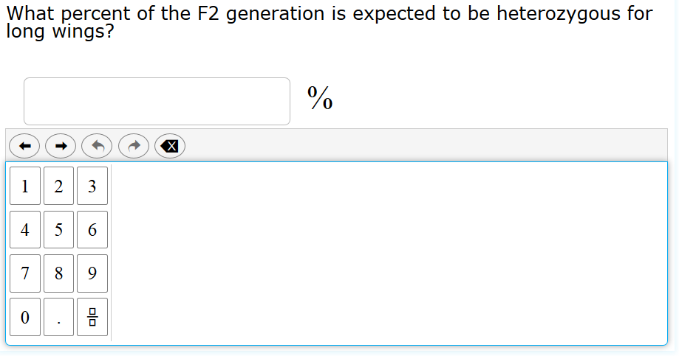
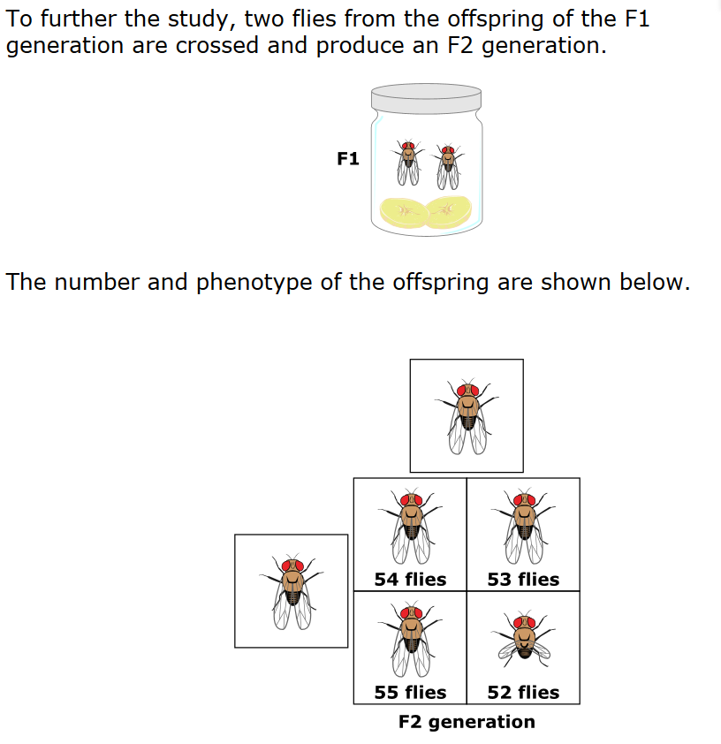
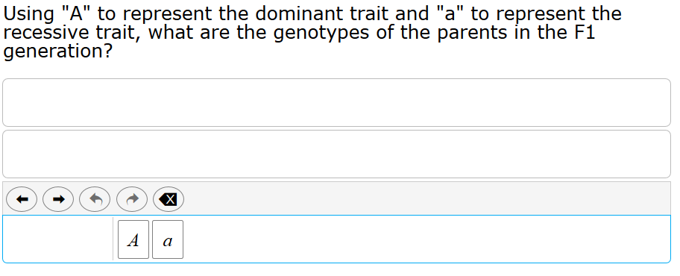
Sample NGSS Assessment Items: from California
High School Example: HS-LS3-3
Some questions not shown
CONNECTICUT STATE DEPARTMENT OF EDUCATION

Slide 26
NGSS Committees of CT Educators
District Advisory Committee (DAC)
Advise on “big picture” issues related to NGSS implementation, professional development, curriculum and assessment development. Includes science leaders and administrators representing over 100 school districts around the state.
State Science Assessment Advisory Committee (SSAAC)
Advise on the development of the NGSS assessment system. Help develop and review items for the statewide NGSS assessments. Includes approximately 60 science educators representing various districts, grades and content areas.
Science Fairness and Accessibility Committee (FAC)
Advise on fairness and accessibility issues for all students regardless of their background or abilities related to NGSS assessments. Includes approximately 20 educators with a variety of backgrounds and expertise.
Contact Ron Michaels (Ronald.Michaels@ct.gov) if interested in the DAC.
Contact Jeff Greig (Jeff.Greig@ct.gov) if interested in the SSAAC or FAC.
CONNECTICUT STATE DEPARTMENT OF EDUCATION

Slide 27
NGSS Assessment Item Development Process (1-2 Years)
1. Drafting of New Items by Testing Contractor*
9. Data Review of Pilot/Field Tested Items
10. Building Operational Tests
2. CSDE Review
of New Items
5. Expert Review
of New Items
3. Content Review of New Items by SSAAC
4. Fairness and Accessibility Review of New Items
6. Pilot/Field Testing of New Items
& Cognitive Labs
7. Rubric Validation & Range-Finding of New Items
8. Scoring of Student Responses to New Items
Only items deemed acceptable following reviews and pilot/field testing are placed on an operational test.
*CT science educators from the State Science Assessment Advisory Committee (SSAAC) help generate phenomena and ideas for assessment items.
CONNECTICUT STATE DEPARTMENT OF EDUCATION

Slide 28
Some NGSS Assessment Resources
Next Generation Science Standards Classroom Tasks
http://www.nextgenscience.org/classroom-sample-assessment-tasks
NSTA Next Generation Science Assessment Resources
http://ngss.nsta.org/conducting-assessments.aspx
Steps to designing a three dimensional assessment
http://stemteachingtools.org/brief/29
How can assessments be designed to engage students in the range of science and engineering practices?
http://stemteachingtools.org/brief/26
Prompts for integrating crosscutting concepts into assessment and instruction
http://stemteachingtools.org/brief/41
The informal formative assessment cycle as a model for teacher practice
http://stemteachingtools.org/brief/16
How teachers can develop formative assessments that fit a three-dimensional view of science learning?
http://stemteachingtools.org/brief/18
Integrating science practices into assessment tasks
http://stemteachingtools.org/brief/30
CONNECTICUT STATE DEPARTMENT OF EDUCATION

Slide 29
Questions?
For further information about science assessments in Connecticut contact:
Jeff Greig
CT State Department of Education
Performance Office
Jeff.Greig@ct.gov
For information about NGSS implementation in Connecticut contact:
Ron Michaels
CT State Department of Education
Academic Office
Ronald.Michaels@ct.gov
CONNECTICUT STATE DEPARTMENT OF EDUCATION

