Slide 1
STEM -- For All Students
Connecticut Science Teachers Association
November 8, 2019
Okhee Lee
New York University

Slide 2
Topics
Topic 1: Overview of the Presentation
Topic 2: Science Instructional Shifts
Topic 3: Science and Language with All Students
Topic 4: Science, Language, and Computational Thinking with All Students

Slide 3
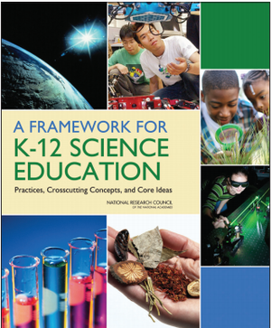
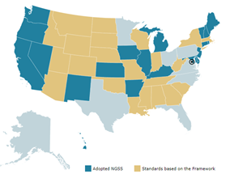
State of Science and Engineering Education
Implementation
Framework
(2012)
NGSS
(2013)
44 States and DC Adoption and Adaptation
Curriculum
Professional Development
Assessment
Materials Support
Administration Support and Community Connections
Research
Policy
Practice

Slide 4
All Standards, All Students: Flip Upside Down
Traditional Contemporary
Scientists and Teachers
Students as Scientists and Engineers
Knowledge of Science Disciplines
Making Sense of Phenomena (Science) and Design Solutions to Problems (Engineering)
Some Students
All Students

Slide 5
Approaches to Reimagine Language Learning
Vocabulary is a precursor or prerequisite: Pre-teach and frontload vocabulary
Instead, language is a product
Disciplinary vocabulary is disciplinary language.
Instead, language is more than vocabulary and includes using language to engage in disciplinary practices and learn disciplinary content
Simplify content, simplify language
Instead, keep content, amplify language

Slide 6
Contemporary Views on Science and Language
Science
Traditional views: Individual learners master science content
Contemporary views: Students make sense of phenomena and design solutions to problems as scientists and engineers do in their work (knowledge-in-use)
Language
Traditional views: Individual learners internalize vocabulary and grammar
Contemporary views: Students use language for a particular purpose in social contexts (language-in-use)
Computational Thinking . . .

Slide 7
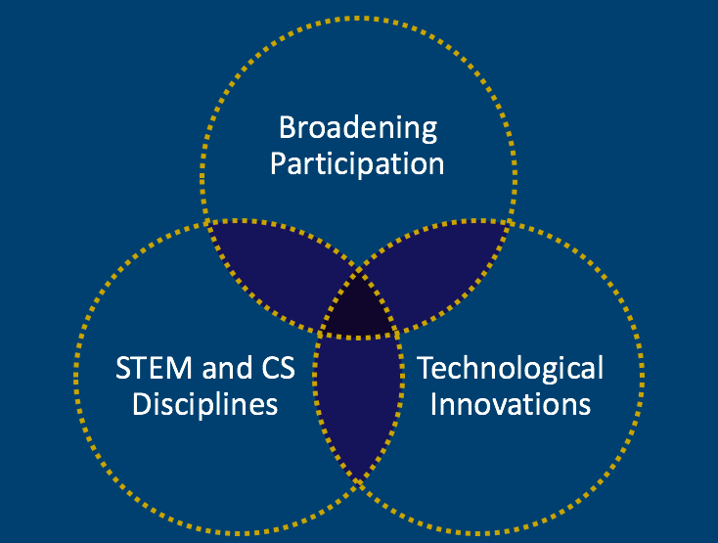
STEM Education for All Students
Convergence

Slide 8
Topics
Topic 1: Overview of the Presentation
Topic 2: Science Instructional Shifts
Topic 3: Science and Language with All Students
Topic 4: Science, Language, and Computational Thinking with All Students

Slide 9
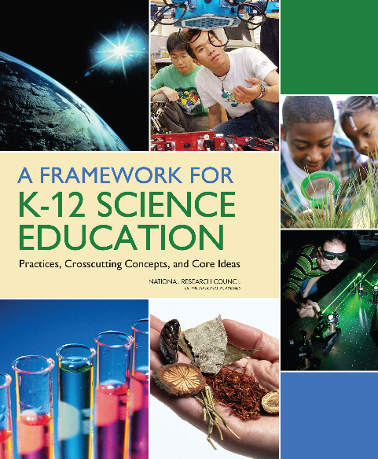
Science Instructional Shifts
Shift 1: Explaining phenomena or designing solutions to problems
Shift 2: Three-dimensional learning
Shift 3: Coherent learning progressions: Build science understanding across time

Slide 10
Shift 1: Why do phenomena matter in science instruction?
The goal of science instruction is to enable students to explain phenomena and design solutions to problems.
Students make sense of phenomena and design solutions to problems as scientists and engineers do in their work.
Making sense of phenomena gives a purpose to science learning as students do something with science.
All of the above.

Slide 11
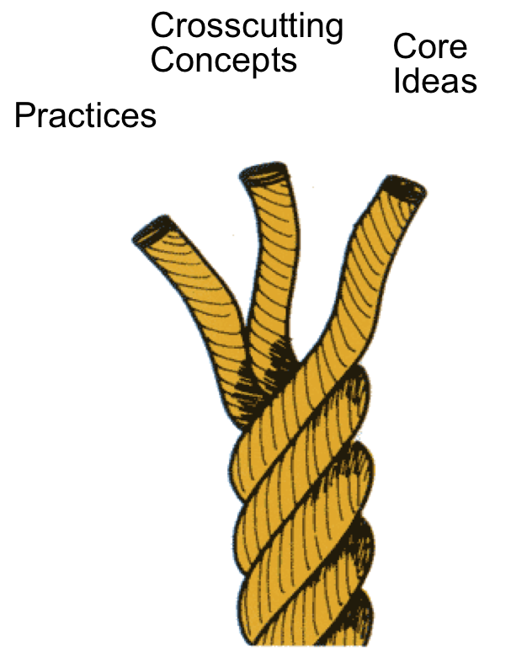
Shift 2: Thee-Dimensional Learning

Slide 12
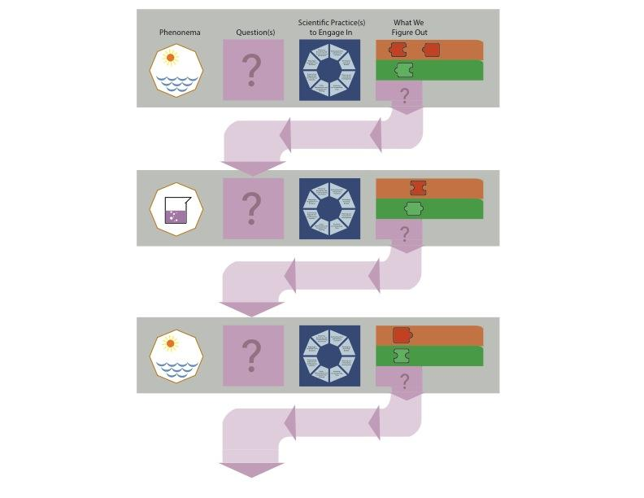
Shift 3: Coherent Learning Progression Over Science Unit
Lessons often raise questions that motivate what we want to figure out in subsequent lessons
Brian Reiser

Slide 13
Shift 3: Coherent Learning Progression Over K-12
1-PS4-2
Make observations to construct an evidence-based account that objects in darkness can be seen only when illuminated.
1-PS4-3
Plan and conduct investigations to determine the effect of placing objects made with different materials in the path of a beam of light.
4-PS4-2
Develop a model to describe that light reflecting from objects and entering the eye allows objects to be seen.
MS-PS4-2
Develop and use a model to describe that waves are reflected, absorbed, or transmitted through various materials.
HS-PS4-3
Evaluate the claims, evidence, and reasoning behind the idea that electromagnetic radiation can be described either by a wave model or a particle model, and that for some situations one model is more useful than the other.

Slide 14
Topics
Topic 1: Overview of the Presentation
Topic 2: Science Instructional Shifts
Topic 3: Science and Language with All Students
Topic 4: Science, Language, and Computational Thinking with All Students

Slide 15
Science And Integrated Language
(SAIL)
Development of Language-Focused Three-Dimensional Science Instructional Materials to Support English Learners in Fifth Grade
Okhee Lee
Lorena Llosa
Guadalupe Valdés
Helen Quinn
This work is supported by the National Science Foundation (NSF Grant DRL-1503330). Any opinions, findings, conclusions, or recommendations expressed in this publication are those of the authors and do not necessarily reflect the position, policy, or endorsement of the funding agency.

Slide 16
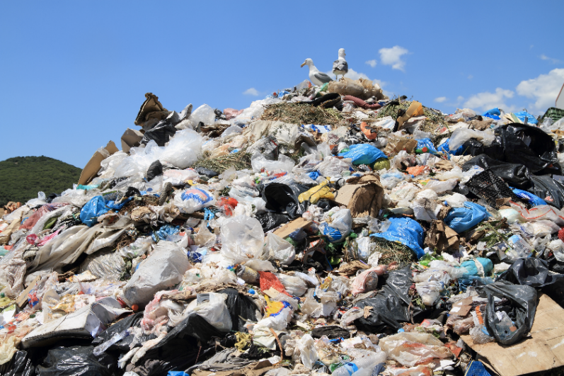
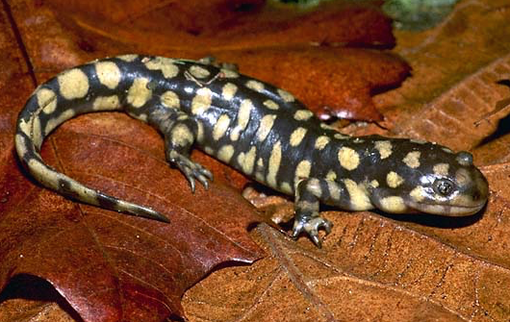
SAIL Yearlong 5th Grade Curriculum
Physical Science:
What happens to our garbage?
Life Science:
Why did the tiger salamanders disappear?
Earth Science:
Why does it matter if I drink tap water or bottled water?
Space Science:
Why do falling stars fall?

Slide 17
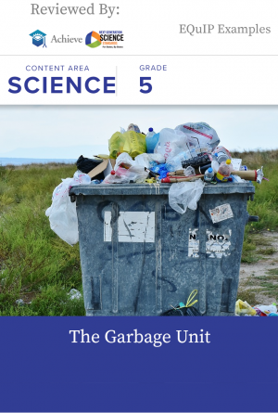
Garbage Unit
Rating: Example of High Quality NGSS Design
Discipline: Physical Science, Life Science
Length: Unit
Awarded the NGSS Design Badge
https://www.nextgenscience.org/resources/grade-5-sail-garbage-unit

Slide 18
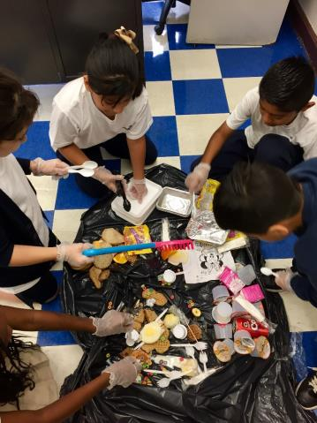
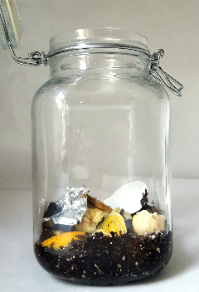
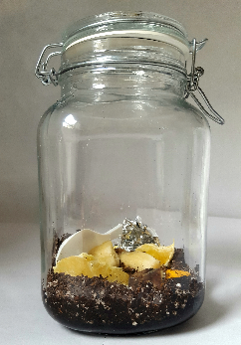
Purpose of SAIL
Develop NGSS-aligned instructional materials for a yearlong, fifth-grade curriculum with a focus on English learners (ELs)
Field test instructional materials with a teacher advisory board in urban school district classrooms with large numbers of ELs

Slide 19
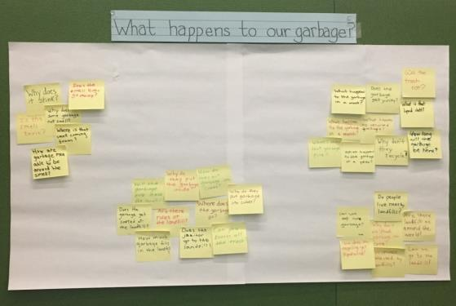
Science Shift 1: Phenomena
SAIL uses phenomena in local contexts of home and community to capitalize on everyday experience and language.
Phenomenon: Our school, home, and community make large amounts of garbage every day.
Question: What happens to our garbage?

Slide 20
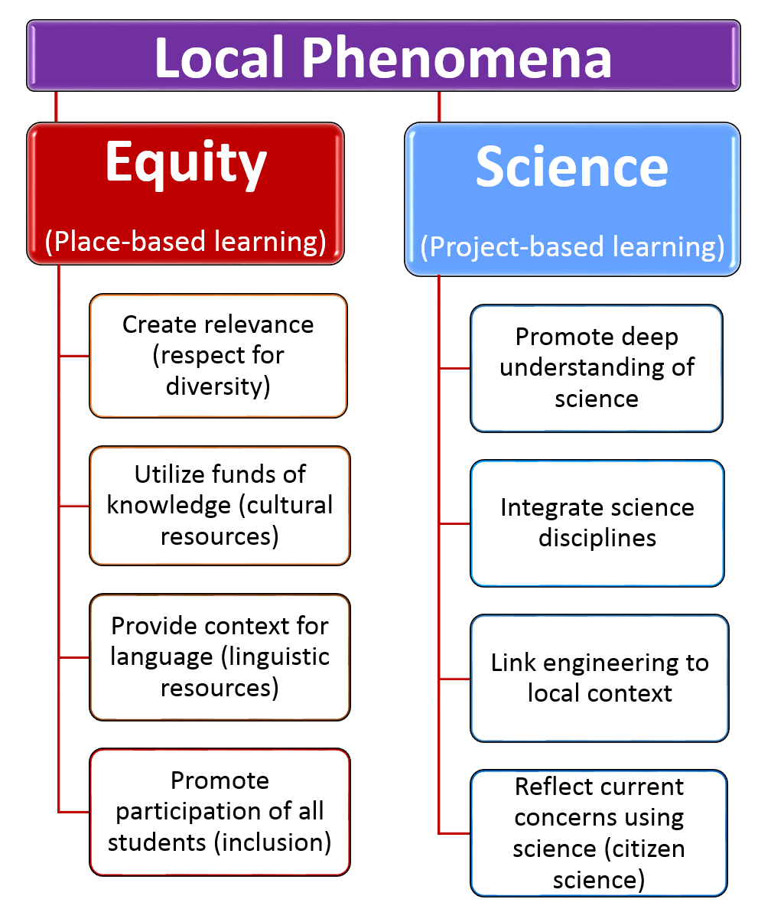
Science Shift 1: Phenomena

Slide 21
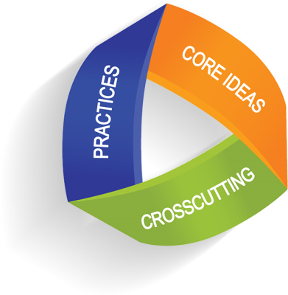
Science Shift 2: Three-Dimensional Learning
Science and engineering practices are language intensive.
What happens to our garbage
(in the real world)?
What happens to our garbage
(in the classroom)?

Slide 22
Science Shift 3: Coherence (“Storyline”)
Students build science understanding over the course of lessons, units, and years of instruction.

Slide 23
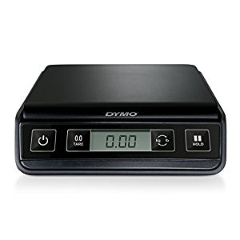
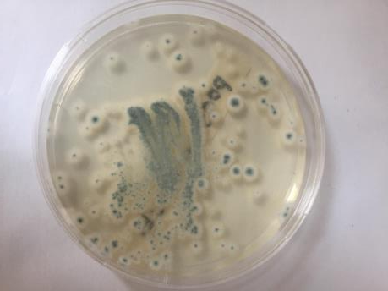
Science Shift 3: Coherence (“Storyline”)
Science learning becomes more sophisticated over time.
3
1
2
3
4

Slide 24
Garbage Unit Science and Engineering Practices
Ask questions (for science) and define problems (for engineering)
Develop and use models
Plan and carry out investigations
Analyze and interpret data
Use mathematics and computational thinking
Construct explanations (for science) and design solutions (for engineering)
Engage in argument from evidence
Obtain, evaluate, and communicate information

Slide 25
Garbage Unit S & E Practices Across Lessons
Science and Engineering Practices | 1-1 | 1-2 | 2-1 | 2-2 | 2-3 | 3-1 | 3-2 | 3-3 | 4-1 | 4-2
Asking questions and defining problems: Ask questions that can be investigated and predict reasonable outcomes based on patterns such as cause and effect relationships. | X | X
Developing and Using Models:
Develop and/or use models to describe and/or predict phenomena. |  | X |  |  | X |  |  | X |  | X
Develop a model using an analogy, example, or abstract representation to describe s scientific principle or design. |  |  |  |  |  |  | X
Planning and carrying out investigations:
Make observations and/or measurements to produce data to serve as evidence for an explanation of a phenomenon or to test a design solution. | X |  | X | X |  | X | X |  |  | X
Conduct an investigation collaboratively to produce data to serve as the basis for evidence, using fair tests in which variables are controlled and the number of trials is considered. |  |  |  |  |  |  |  |  | X
Analyzing and interpreting data: Represent data in table and/or various graphical displays (bar graphs, pictographs and/or pie charts) to reveal patterns that indicate relationships. |  |  |  |  |  |  |  | X
Using mathematics and computational thinking: Describe, measure, estimate, and/or graph quantities such as area, volume, weight, and time to address scientific and engineering questions and problems. |  |  |  |  |  |  | X | X
Constructing explanations and designing solutions: Identify the evidence that supports particular points in an explanation. |  |  |  |  |  |  |  |  |  | X
Engaging in argument from evidence: Construct and/or support an argument with evidence, data, or a model. |  |  |  | X |  |  |  |  | X
Obtaining, evaluating, and communicating information: Obtain and/or combine information across complex texts and/or reliable media to support the engagement in other scientific and/or engineering practices. |  |  |  |  |  |  |  |  |  | X

Slide 26
Garbage Unit Disciplinary Core Ideas
PS1.A: Structure and Properties of Matter
Measurements of a variety of properties can be used to identify materials. The amount (weight) of matter is conserved when it changes form, even in transitions in which it seems to vanish. Matter of any type can be subdivided into particles that are too small to see, but even then the matter still exists and can be detected by other means.
PS1.B: Chemical Reactions
When two or more different substances are mixed, a new substance with different properties may be formed. No matter what reaction or change in properties occurs, the total weight of the substances does not change.
LS2.A: Interdependent Relationships in Ecosystems (partial)
Some organisms, such as fungi and bacteria, break down dead organisms and therefore operate as “decomposers.”
LS2.B: Cycles of Matter and Energy Transfer in Ecosystems (partial)
Matter cycles between the air and soil and among plants, animals, and microbes as these organisms live and die.

Slide 27
Garbage Unit Disciplinary Core Ideas Across Lessons
Disciplinary Core Ideas | 1-1 | 1-2 | 2-1 | 2-2 | 2-3 | 3-1 | 3-2 | 3-3 | 4-1 | 4-2
PS1.A Structure and Properties of Matter
Measurements of a variety of properties can be used to identify materials. |  | X | X | X | X | X
The amount (weight) of matter is conserved when it changes form, even in transitions in which it seems to vanish. |  |  |  | X |  | X |  | X | X
Matter of any type can be subdivided into particles that are too small to see, but even then, the matter still exists and can be detected by other means. |  |  |  |  | X |  | X
A model showing that gases are made from matter particles that are too small to see and are moving freely around in space can explain many observations, including the inflation and shape of a balloon and the effects of air on larger particles or objects. |  |  |  |  |  |  | X
(Grade 2) Different kinds of matter exist. You can distinguish materials by their observable properties. | X
PS1. B Chemical Reactions:
No matter what reaction or change in properties occurs, the total weight of the substances does not change. |  |  | X |  |  |  |  | X | X
When two or more different substances are mixed, a new substance with different properties may be formed. |  |  |  |  |  |  |  |  | X
LS2.A Interdependent Relationships in Ecosystems (partial DCI): Some organisms, such as fungi and bacteria, break down dead organisms (both plants or plants [sic] parts and animals) and therefore operate as decomposers. |  |  |  |  |  |  |  |  |  | X
LS2.B Cycles of Matter and Energy Transfer in Ecosystems (partial DCI): Matter cycles between air and soil and among plants, animals, and microbes as these organisms live and die. |  |  |  |  |  |  |  |  |  | X

Slide 28
Garbage Unit Crosscutting Concepts
Patterns
Cause and effect
Scale, proportion, and quantity
Systems and system models
Energy and matter
Structure and function
Stability and change

Slide 29
Garbage Unit Crosscutting Concepts Across Lessons
Crosscutting Concepts | 1-1 | 1-2 | 2-1 | 2-2 | 2-3 | 3-1 | 3-2 | 3-3 | 4-1 | 4-2
Patterns:
Patterns can be used as evidence to support an explanation. |  |  |  | X
Similarities and differences in patterns can be used to sort, classify, communicate and analyze simple rates of change for natural phenomena and designed products. | X |  |  | X
Cause and effect – mechanism and prediction: Cause and effect relationships are routinely identified, tested, and used to explain change. |  |  |  |  |  |  |  |  |  | X
Scale, proportion, and quantity: Natural objects exist from the very small to the immensely large. |  |  |  |  |  |  | X
Energy and Matter – flows, cycles, and conservation:
Matter is made of particles. |  |  |  |  | X |  | X
Matter flows and cycles can be tracked in terms of the weight of the substances before and after a process occurs. The total weight of the substances does not change. This is what is meant by conservation of matter. Matter is transported into, out of, and within systems. |  |  |  |  |  | X |  | X | X
Systems and system models:
A system is a group of related parts that make up a whole and can carry out functions its individual parts cannot. |  |  | X
A system can be described in terms of its components and their interactions. |  | X

Slide 30
Language Shifts
Modalities | Registers | Interactions
Linguistic Talk (oral language) Text (written language) Visual Drawing Symbol Table Gesture | Everyday Specialized language language Precision: Do ELs communicate disciplinary meaning with exactness? | One-to-one One-to-small group One-to-many Small group-to-many Explicitness: Do ELs communicate disciplinary meaning beyond the “here” and “now”?
Lee, Quinn, & Valdés (2013)

Slide 31
Language Shifts: Example

Slide 32
What is That Smell?
Language Shifts: Example

Slide 33
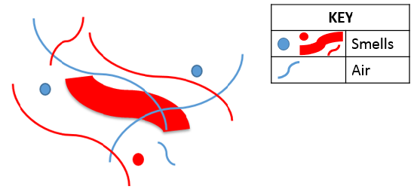
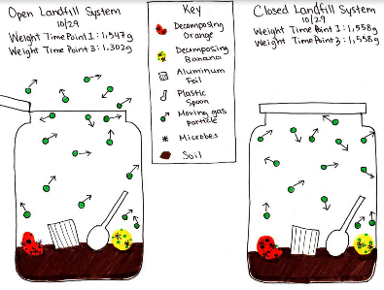
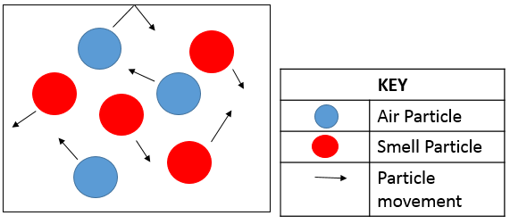
Modalities
Students use multiple modalities in increasingly strategic ways over time.
2
4
1
Smell
3
Talk, text, diagrams, symbols, tables, graphs, etc.

Slide 34
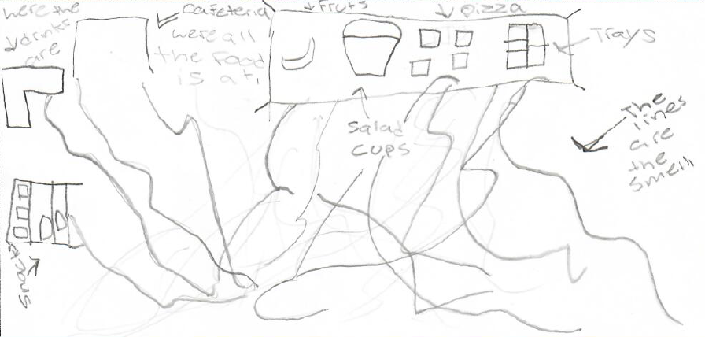
Modalities
Beginning of a lesson cluster

Slide 35
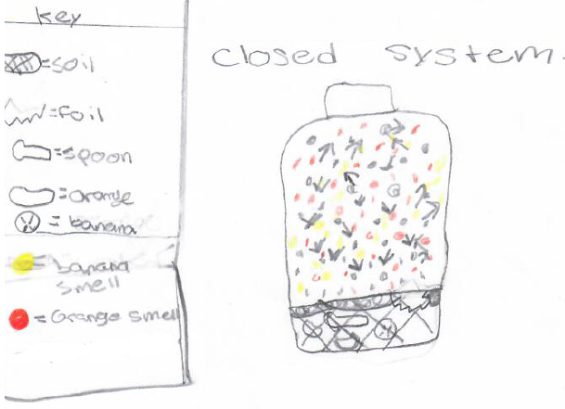
Modalities
End of a lesson cluster

Slide 36
Modalities
Traditional thinking: Multimodality is viewed differently across subject areas:
ELA views multimodality in terms of language (i.e., listening, speaking, reading, writing)
English language education views multimodality as supports or scaffolds toward (written) language
Science education views multimodality (e.g., graphs, charts, diagrams) as essential for the disciplines

Slide 37
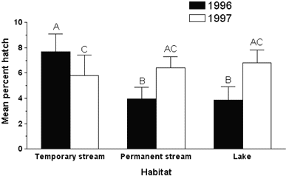
Modalities
Math & Science Education
EL Education
Contemporary thinking: Modalities (especially nonlinguistic) are essential to engagement in disciplinary practices AND beneficial to ELs

Slide 38
Registers
Students progress from everyday to specialized registers over time
Smell is something. It’s a gas.
Smell is a gas made of particles.
EWWW! It stinks!
Smell is a gas made of particles too small to see moving freely in space.
From everyday to specialized registers

Slide 39
Registers
Beginning of a lesson cluster
Midpoint of a lesson cluster
End of a lesson cluster

Slide 40
Registers
Traditional thinking: Language is a “precursor” or “prerequisite” for doing science
Contemporary thinking: Language is a “product” of doing science

Slide 41
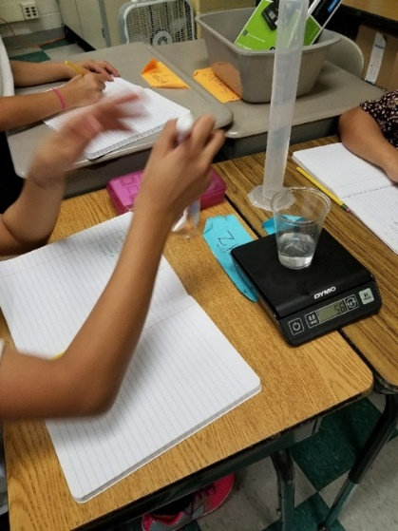
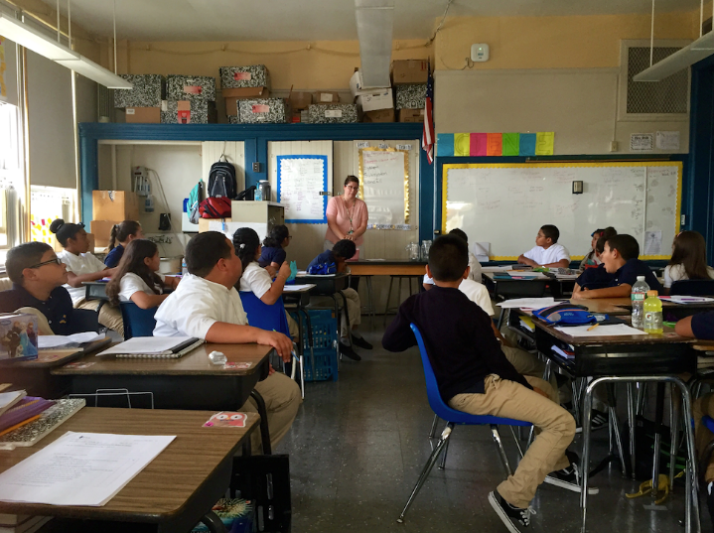
Interactions
The sugar mixed with the water.
I don’t see it in there.
As students use language to “do” science, they engage in different types of interactions.
One-to-Small Group
One-to-Many

Slide 42
Interactions
Traditional thinking: Enforce the use of disciplinary language
Contemporary thinking:
Enforcing the use of disciplinary language could short-circuit opportunities to learn disciplinary content
Guide students in adapting language in different types of interactions

Slide 43
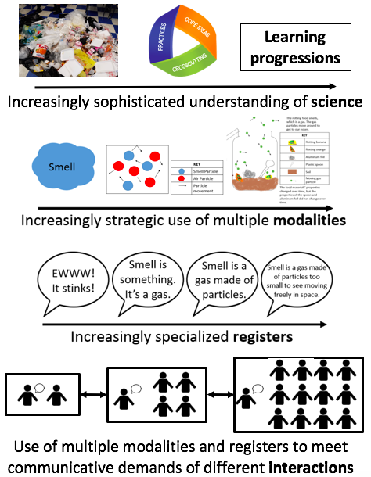

Slide 44
Topics
Topic 1: Overview of the Presentation
Topic 2: Science Instructional Shifts
Topic 3: Science and Language with All Students
Topic 4: Science, Language, and Computational Thinking with All Students

Slide 45
SAIL + CTM
(Computational Thinking and Modeling)
Okhee Lee
Lorena Llosa
Eric Klopfer
Daniel Wendel
Corey Brady
Douglas Clark
This work is supported by the National Science Foundation (NSF Grant DRL-1742138). Any opinions, findings, conclusions, or recommendations expressed in this publication are those of the authors and do not necessarily reflect the position, policy, or endorsement of the funding agency.

Slide 46
SAIL + CTM
Science And Integrated Language Plus Computational Thinking And Modeling (SAIL + CTM)
The purpose is to expand and refine SAIL by integrating CTM
The project builds upon the work of SAIL (NYU) and StarLogo Nova (MIT)

Slide 47
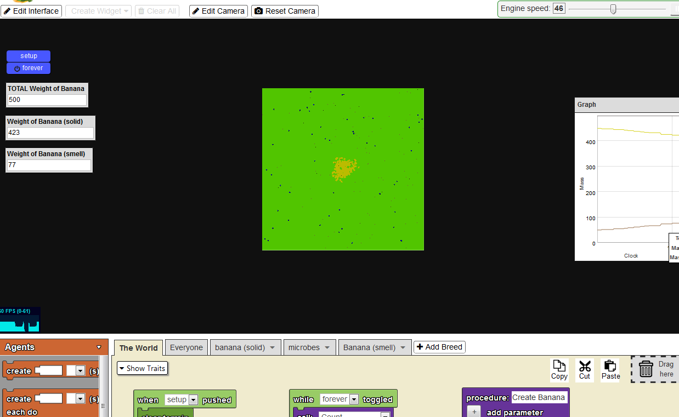
Models in the Garbage Unit
Physical Model
Diagrammatic Model
Computational Model

Slide 48
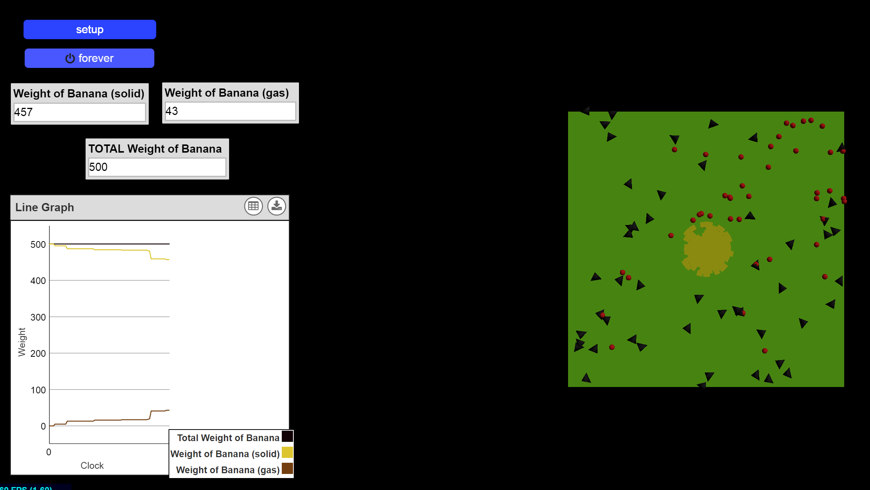
Computational Model to Explain Decomposition Caused by Microbes (Science)
Microbes
Banana (solid)
Banana (gas)

Slide 49
Earth Science:
Computational Model to Solve Problem of Plastic Pollution (Engineering)
Earth Science:
Why does it matter if I drink tap water or bottled water?
Engineering Design:
How can we help solve the problem that plastic pollution from bottled water harms ocean animals?

Slide 50
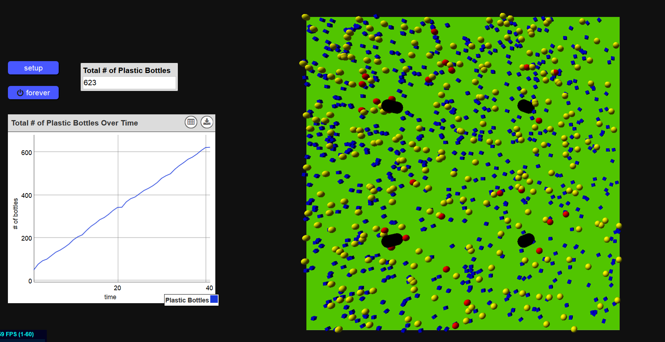
Computational Model to Solve Problem of Plastic Pollution (Engineering)
Example: Social media campaign to get more students at their school to use water fountains, instead of plastic water bottles
People
Plastic Water Bottles
Water fountains
People converted to reusable water bottles (25%)

Slide 51
Language Use and Computational Thinking in Service of Science and Engineering with English Learners
Modalities | Registers | Interactions
Language Use Linguistic Visual Computational Thinking Agent-based modeling | Language Use Everyday Specialized language language Computational Thinking Blocks-based modeling environment | Language Use One-to-one One-to-small group One-to-many Small group-to-many Computational Thinking Interactions with and about computational modeling

Slide 52
STEM Education for All Students
Convergence

Slide 53
References on Science and Language
National Academies of Sciences, Engineering, and Medicine. (2018). English learners in STEM subjects: Transforming classrooms, schools, and lives. Washington, DC: National Academies Press.
The report is available for free online at: https://www.nap.edu/download/25182
Haas, A., Whitten, J., & Biskupic-Night, C. (in press). NGSS science and language shifts in a diverse fourth-grade classroom. Science and Children.
Lee, O., Llosa, L., Grapin, S. E., Haas, A., & Goggins, M. (2019). Science and language integration with English learners: A conceptual framework guiding instructional materials development. Science Education. 103, 317-337.
Lee, O., Quinn, H., & Valdés, G. (2013). Science and language for English language learners in relation to Next Generation Science Standards and with implications for Common Core State Standards for English language arts and mathematics. Educational Researcher, 42(4), 223-233.

Slide 54
Questions and Answers

Slide 55
Thank You!

